Slide 1


INFO5990 Professional Practice in IT Lecture 12B
Business Intelligence
Online analytical processing (OLAP)

Slide 2

By the end of this lecture you will be able to:
Understand what business intelligence is
Explain the benefits of using business intelligence tools (ETL)
Understand the nature of online analytical processing (OLAP) Cube
BI
Extract – Transform-Load
OLAP
DATA

Slide 3
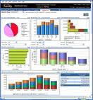


What is Business Intelligence?
Business Intelligence enables the business to make intelligent, fact-based decisions
Aggregate Data
Present
Data
Enrich
Data
Inform a Decision
Database, Data Mart, Data Warehouse, ETL Tools, Integration Tools
Reporting Tools, Dashboards, Static Reports, Mobile Reporting, OLAP Cubes
Add Context to Create Information, Descriptive Statistics, Benchmarks, Variance to Plan or LY
Decisions are Fact-based and Data-driven

Slide 4
How Important is BI?
Top 10 Business and Technology Priorities for 2011:
1. Cloud computing 2. Virtualization 3. Mobile technologies 4. IT Management 5. Business Intelligence 6. Networking, voice and data communications 7. Enterprise applications 8. Collaboration technologies 9. Infrastructure 10. Web 2.0
Source: Gartner’s 2011 CIO Agenda (aka “Reimagining IT: The 2011 CIO Agenda”).

Slide 5
Why is Business Intelligence So Important?
Time
Data
Opinion
(aka Best Professional Judgment)
Making Business Decisions is a Balance
With Business Intelligence, we can get data to you in a timely manner.
In the absence of data, business decisions are often made by the HiPPO.

Slide 6
Current & Major BI Trends
Mobile
Cloud
Social Media
Advanced Analytics

Slide 7

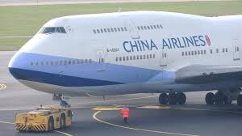


Unstructured Text Processing
Facebook Page
Twitter
Page
Customer Sat Survey Comments
Call
Center
Notes,
Voice
Services
Quality
Cost
Friendliness
Competitors’ Facebook
Pages
Public Web Sites,
Discussion Boards, Product Reviews
Email
Blogs
Adhoc Feedback
Alerts,
Real-time Action

Slide 8
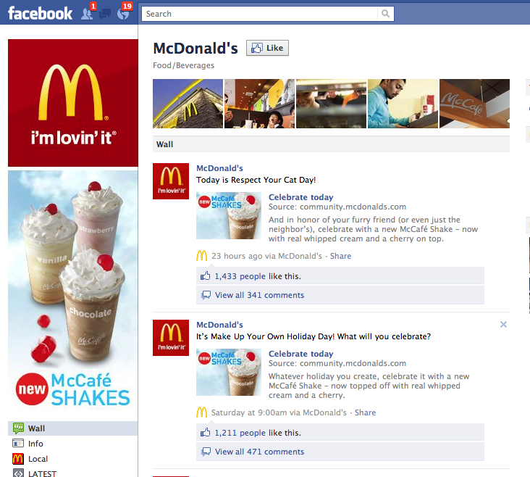
Example of BI in business ?

Slide 9
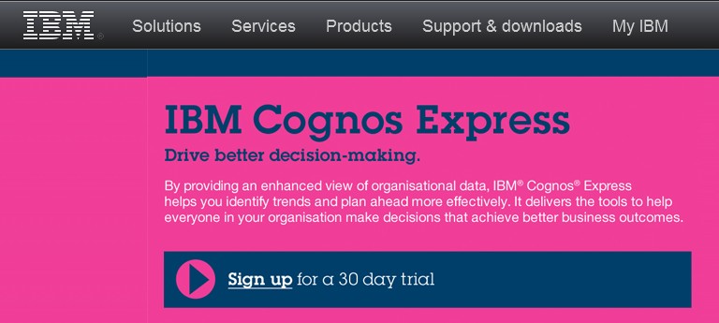





Business intelligence tools

Slide 10
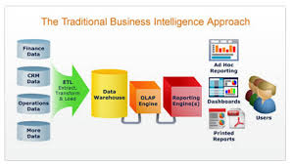
Four key components of a business intelligence system
data warehouse containing both internal and external data
business analytic tools for manipulating, mining, and analyzing data
a set of business performance indicators for monitoring and analyzing performance
user interface

Slide 11
Benefits of business intelligence tools
‘One version of the truth’ – a single, reliable presentation of corporate information
Alignment of an organization around a consistent set of Key Performance Indicators (KPIs) and Metrics
Integrated access to multiple data sources (ERP, CRM, Spreadsheets, Budgets, etc.)
Faster collection and dissemination of information.
Simplified graphical presentation of KPIs and metrics
Quicker, better, fact-based decision making

Slide 12
Perceived benefits
A survey of 1047 companies in Nov 2012 by Nigel Pendse showed that they thought benefits were real.
Benefit | % of Companies Realizing Benefit
Faster, more accurate reporting | 81
Improved decision making | 78
Improved customer service | 56
Increased revenue | 49
Savings in non-IT costs | 50
IT savings | 40

Slide 13
Q1. The Business Intelligence system in any organisation is intended to provide information for:
making strategic and tactical decisions
forecasting demand for goods & services
optimising operational decisions
facilitating effective human resource management
ALL of the above

Slide 14
Q2. Which of the following is NOT thought of as an essential component of a Business Intelligence system
a set performance indicators
a data warehouse
a strategic business plan
a set business analytic tools
a user interface

Slide 15
A Business intelligence system provides accurate information when needed, about the organisation and its environment, including a (nearly) real-time view of corporate status and performance
To summarise - BI

Slide 16
ETL tools Extract-Transform-Load
Extract data from multiple diverse data sources including those outside the organisation
Transform data to fit operational needs, including ‘cleansing’ (quality)
Load data into target database, data mart or data warehouse
ETL ‘World Record’: 5.4 TB data loaded in Under 1 Hour (Syncsort)
Click here for Intricity ETL tool (4:59)

Slide 17
Data Integration The Extract, Transform and Load (ETL) Process

Slide 18
Data Warehouse
A physical repository where relational data are specially organized to provide enterprise-wide, cleansed data in a standardized format
“The data warehouse is a collection of integrated, subject-oriented databases design to support DSS functions, where each unit of data is non-volatile and relevant to some moment in time.”

Slide 19
Characteristics of a data warehouse
Subject oriented
Integrated
Time-variant (time series)
Nonvolatile
Summarized
Non-normalized
Metadata
Web based, relational/multi-dimensional
Client/server
Real-time and/or right-time (active)

Slide 20
Benefits of a data warehouse
One view of the corporate data
Allows end users to perform extensive analysis more efficiently
Allows a consolidated view of corporate data
Better quality data
More timely information
Enhanced system performance
Simplified data access

Slide 21
Factors affecting the effectiveness of a data warehouse
Suitability of dimensions as defined by IT specialists
Quality of data
Frequency of update
It is difficult to suit everyone

Slide 22
Q3. Which of the following is NOT usually a function of an ETL tool?
Removing anomalies from transaction data
Capturing data at point of sale activities
Accessing external data sources
Reformatting data according to fixed rules
ALL of these are usual ETL functions

Slide 23
Q4. Which of the following statements concerning a data warehouse is FALSE?
It contains cleansed data in a standardized format
It represents an integrated, subject-oriented database
Each unit of data is non-volatile
It reflects the current status of the organisation
NONE of these is false

Slide 24
Online Analytical Processing (OLAP)
Provides advanced tools for decision making
An approach to answering ad hoc multi-dimensional analytical queries
Part of the broader field of ‘business intelligence’
Incorporates reporting and data mining

Slide 25
The OLAP cube
‘OLAP cube’
a generalisation of a two-dimensional spreadsheet
an array of data of three or more dimensions
multidimensional dataset
sometimes then called hypercube
World’s largest cube 1.4 terabytes
Average response time 1.2 seconds

Slide 26
Dimensions, hierarchies & measures
Dimensions:
an aspect of the business: product, customer, store, time-period, actual and budget expenses
described by a set of attributes, e.g. product has attributes category, industry, model number, year of introduction
Hierarchies:
the attributes of a dimension can be in hierarchies: each attribute being a ‘child’ of the previous parent level, e.g. Year, Quarter, Month, Day, time of day
Measures:
each cell of cube holds a number, some fact about the business, e.g. sales, profits, expenses, budget, forecast
Grain:
A question of how finely grained to store data

Slide 27
Properties of an OLAP cube
Separate from the ‘live system’
Extracted from transaction data
May also include external data
Not ‘normalised’ - includes data duplication
Pre-processed - optimised for ad hoc queries, aggregated along dimensions
Not ‘real time’ - may lag behind reality
Must be updated systematically at specified time intervals, hourly, monthly
Absorbs computing resources, both storage and processing power

Slide 28
Normalised data
RESULT
ID | CODE | MARK
1 | INFO2000 | 77
1 | MATH1001 | 52
1 | SOFT1001 | 67
1 | SOFT1002
2 | INFO2000 | 67
2 | INFO3005 | 34
2 | MATH1001 | 23
3 | INFO2000
3 | INFO3005 | 84
3 | MATH1001 | 74
3 | MATH1002
3 | SOFT1001
3 | SOFT1002
4 | INFO2000
4 | SOFT1001 | 56
5 | INFO2000 | 92
5 | INFO3005 | 67
5 | MATH1002
7 | MATH1001 | 99
7 | MATH1002
STUDENT
ID | SURNAME | FIRSTNAME | GENDER | DOB
1 | SMITH | Harry | M | 1/12/1980
2 | JONES | Calvin | M | 8/01/1981
3 | JONES | Cassandra | F | 5/02/1982
4 | LA PLANTE | Jennie | F | 12/07/1981
5 | O'HARAH | Jacqueline | F | 12/12/1981
7 | HARRIS | Jane | F | 5/12/1982
8 | DEL GRANDE | Caterina | F | 5/03/1980
9 | JONES | Charles | M | 4/01/1983
UNIT
CODE | DESCRIPTION | POINTS
INFO2000 | Systems Analysis & Design | 4
INFO3005 | Organisational DB Systems | 4
MATH1001 | Differential Calculus | 3
MATH1002 | Integral Calculus | 3
SOFT1001 | Software Development 1 | 6
SOFT1002 | Software Development 2 | 6

Slide 29
Flat file
ID | SURNAME | FIRSTNAME | CODE | DESCRIPTION | MARK | POINTS
1 | SMITH | Harry | INFO2000 | Systems Analysis & Design | 77 | 4
1 | SMITH | Harry | MATH1001 | Differential Calculus | 52 | 3
1 | SMITH | Harry | SOFT1001 | Software Development 1 | 67 | 6
1 | SMITH | Harry | SOFT1002 | Software Development 2 |  | 6
2 | JONES | Calvin | INFO2000 | Systems Analysis & Design | 67 | 4
2 | JONES | Calvin | INFO3005 | Organisational DB Systems | 34 | 4
2 | JONES | Calvin | MATH1001 | Differential Calculus | 23 | 3
3 | JONES | Cassandra | INFO2000 | Systems Analysis & Design |  | 4
3 | JONES | Cassandra | INFO3005 | Organisational DB Systems | 84 | 4
3 | JONES | Cassandra | MATH1001 | Differential Calculus | 74 | 3
3 | JONES | Cassandra | MATH1002 | Integral Calculus |  | 3
3 | JONES | Cassandra | SOFT1001 | Software Development 1 |  | 6
3 | JONES | Cassandra | SOFT1002 | Software Development 2 |  | 6
4 | LA PLANTE | Jennie | INFO2000 | Systems Analysis & Design |  | 4
4 | LA PLANTE | Jennie | SOFT1001 | Software Development 1 | 56 | 6
5 | O'HARAH | Jacqueline | INFO2000 | Systems Analysis & Design | 92 | 4
5 | O'HARAH | Jacqueline | INFO3005 | Organisational DB Systems | 67 | 4
5 | O'HARAH | Jacqueline | MATH1002 | Integral Calculus |  | 3
7 | HARRIS | Jane | SOFT1001 | Software Development 1 | 76 | 6
8 | DEL GRANDE | Caterina | INFO2000 | Systems Analysis & Design | 45 | 4
8 | DEL GRANDE | Caterina | INFO3005 | Organisational DB Systems |  | 4
8 | DEL GRANDE | Caterina | MATH1002 | Integral Calculus |  | 3
Note data duplication

Slide 30

Structure of OLAP cube
Stored in ‘star’ or ‘snowflake’ schema
Dimensions stored in ‘dimension tables’
Elements of a dimension are organised as a ‘hierarchy’
Actual values are stored in ‘fact table’
Each cell contains a number (measure) representing sales, profit, expenses, forecasts, names and addresses, etc.

Slide 31
Snowflake schema
DAY
Mon
Tue
Wed
Thu
Fri
MONTH
STATE
Jan
Feb
Mar
Apr
May
June
NSW
VIC
QLD
WA
SA
NT
YEAR
2006
2005
2004
2003
FACT TABLE
132
142
500
3
29.95
43.95
12
345.00
32
189
78
SALESPERS.
DEPARTMENT
Jane
William
Robert
Ursula
Chen
Kitchenware
Bedding
White goods
TV & Video
Sporting
Garden
Furniture
CATEGORY
Wash mach.
Refrigerator
Freezer
Cook top
Dish washer
Disposal
ITEM
Model 42
Simpson F1
Hoover 16
Hover 18A
F & Paykel
Simpson V4

Slide 32
OLAP operations
Slicing
Dicing
Drill down
Roll up
Pivot

Slide 33
Slicing
2006
2005
2004
2004
Kitchenware
Kitchenware
Bedding
Bedding
White goods
White goods
TV & Video
TV & Video
Sporting
Sporting
NSW VIC QLD
NSW VIC QLD

Slide 34
Dicing
2006
2005
2006
2004
2005
Kitchenware
2004
Bedding
Bedding
White goods
White goods
TV & Video
TV & Video
Sporting
NSW VIC QLD

Slide 35
Drilling down
2006
2005
2004
2006
Kitchenware
2005
Bedding
2004
White goods
Refrigerators
TV & Video
Freezers
Sporting
Dish washers
NSW VIC QLD
NSW VIC QLD

Slide 36
Rolling up
2006
2005
2004
2006
Kitchenware
2005
Bedding
2004
White goods
Refrigerators
TV & Video
Freezers
Sporting
Dish washers
NSW VIC QLD
NSW VIC QLD

Slide 37
Pivoting
2006
2005
2004
Sporting
TV & Video
Kitchenware
White goods
Bedding
Kitchenware
Bedding
2006
White goods
2005
TV & Video
2004
Sporting
NSW VIC QLD
NSW VIC QLD

Slide 38
OLAP operations
Slicing – selecting a ‘rectangular’ subset by choosing a single value of one dimension
Dicing – selecting one or more specific values from a dimension
Drill down – access the ‘child’ values of a parent
Roll up (consolidation) – summarize data along a dimension, or calculate a derived value, say profit
Pivoting – rotate cube in space to see a different ‘face’

Slide 39
Q5. Which of the following statements concerning the OLAP data cube is FALSE?
The cube is a copy of the organisation data base
Each view of the data in the cube is called a dimension
Dimensions are organised into hierarchies
Data in the OLAP must be updated regularly
NONE of these is false

Slide 40
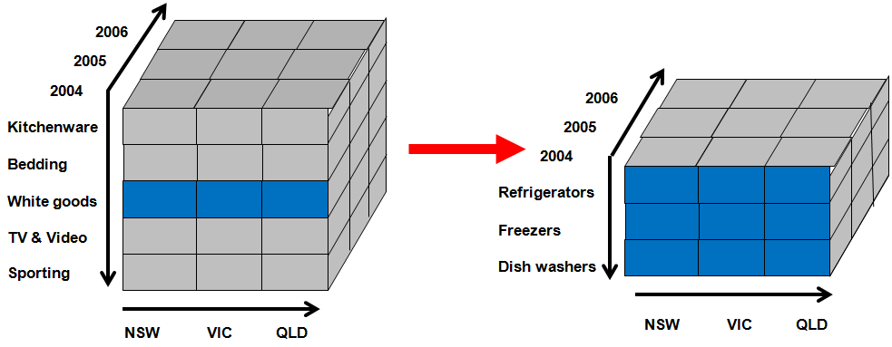
Q6. Which of the OLAP operations is represented by the following diagram?
Slicing
Dicing
Drilling down
Rolling up
NONE of these

Slide 41
What’s next?
Unstructured data
Big data

Slide 42
Unstructured data
85 percent of all business information exists as unstructured data (Merrill Lynch, 2003)
news, reports, letters, e-mails, memos, notes from call centres or customer support, user groups, chats, surveys, white papers, marketing material, research, PowerPoint presentations, Web pages
white collar workers spend 30-40% of their time managing documents (Gartner, 2003)
2 billion Web pages created since 1995
200 million pages being added every month*
“Semi-structured”: In many cases meta-data exists which can be used to classify and correlate, e.g. HTML, XML
* International Data Corporation (IDC) An organisation providing market research, analysis and advice on information technology and telecommunications

Slide 43
The next move: Content intelligence
Advanced search tools
draw on context and meta-data to specify more precisely
Classification
placing unstructured documents within a taxonomy
automated tools for building and maintaining taxonomies
Discovery software
generates meta data from documents and classifies the documents
Example: analyzing product defect information for heavy equipment to tailor parts and services

Slide 44
Bonus Question 7
Write down your score /7
Which of the following is/are an example of “unstructured data”?
(A) Data representing discontinued products
(B) Free text comments in the ‘comment’ column of an order screen
(C) Data included in tags in an HTML document
(D) Price and availability data in an email
(E) NONE of these
Bonus
question

Slide 45
Next week
Exam Tips –tell your friends
Discussion & Debate
Guest Lecture
Practice the sample exam questions for next week’s class
Last class – hurray !

